Slide 1


2024 HCA Single-Cell Omics in-person Computational and Experimental Design Workshop Pre-processing and Quality Control
June 24-28, 2024
Bangkok, Thailand

Slide 2
Computational track schedule
 | Beginner | Advanced
Monday | Preprocessing/QC | Data integration/cell type annotation/DE
Tuesday | Clustering/DE/data integration/cell type annotation | multi-omics/DA
Wednesday | TCR/BCR/CITE-Seq
Thursday | Trajectory inference/cell-cell communication
Friday | project/presentation

Slide 3
Module 1 - pre-processing, quality control, normalization
1a. Going from raw sequencing files to gene count matrices.
1b. Working with count matrices:
Basics of bioinformatics tool-kits in omics research.
Quality control and normalization starting from gene count matrices.
Interacting with single-cell data in R: Seurat objects.

Slide 4
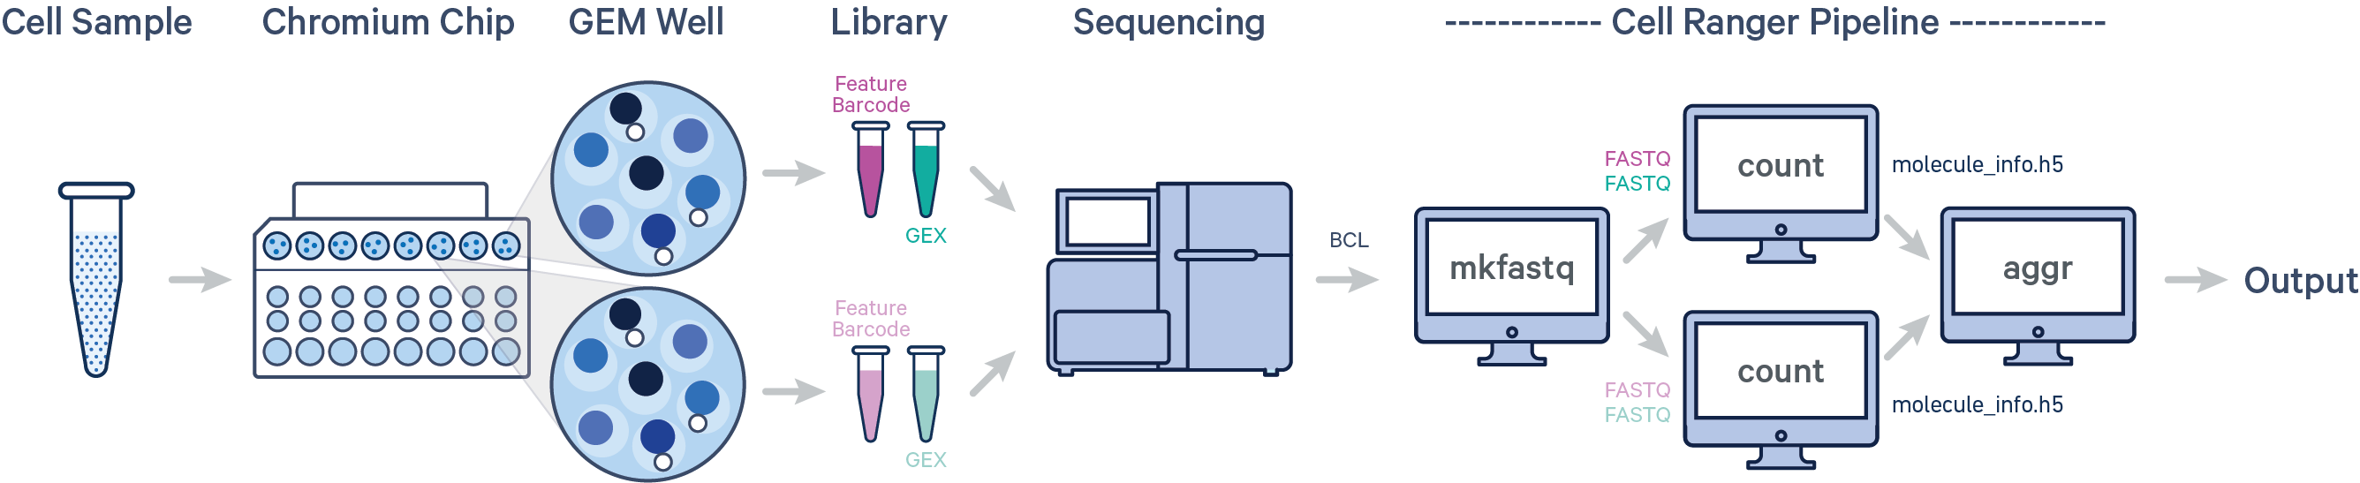
Raw sequencing files to gene count matrices
Source: 10X Genomics

Slide 5
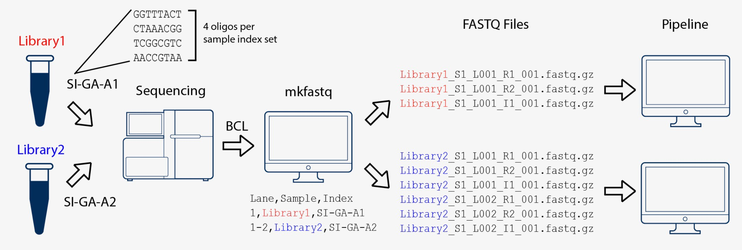
Raw sequencing files to count matrices
Step 1: BCL to FASTQ
The primary output of Illumina sequencing instruments are per-cycle base call files in BCL format.
The first step is to convert these BCL files to fastq files. Steps include separating reads into individual fastq files based on their barcode (demultiplexing) and moving unique molecular identifier (UMI) bases from the read to the fastq header.
Tools: cellranger mkfastq, bcl2fastq or BCL Convert
Source: 10X Genomics

Slide 6
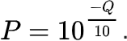
Raw sequencing files to count matrices
Step 1: BCL to FASTQ
A FASTQ file is a text file that contains the sequence data which consists of:
A sequence identifier with information about the sequencing run and the cluster.
The sequence (the base calls; A, C, T, G and N).
A separator, which is simply a plus (+) sign.
The base call quality scores as phred scores
Example sequence in a FASTQ
@HWI-ST808:130:H0B8YADXX:1:1101:2088:2222:CELL_GGTCCA:UMI_CCCT AGGAAGATGGAGGAGAGAAGGCGGTGAAAGAGACCTGTAAAAAGCCACCGN
+ @@@DDBD>=AFCF+<CAFHDECII:DGGGHGIGGIIIEHGIIIGIIDHII#

Slide 7
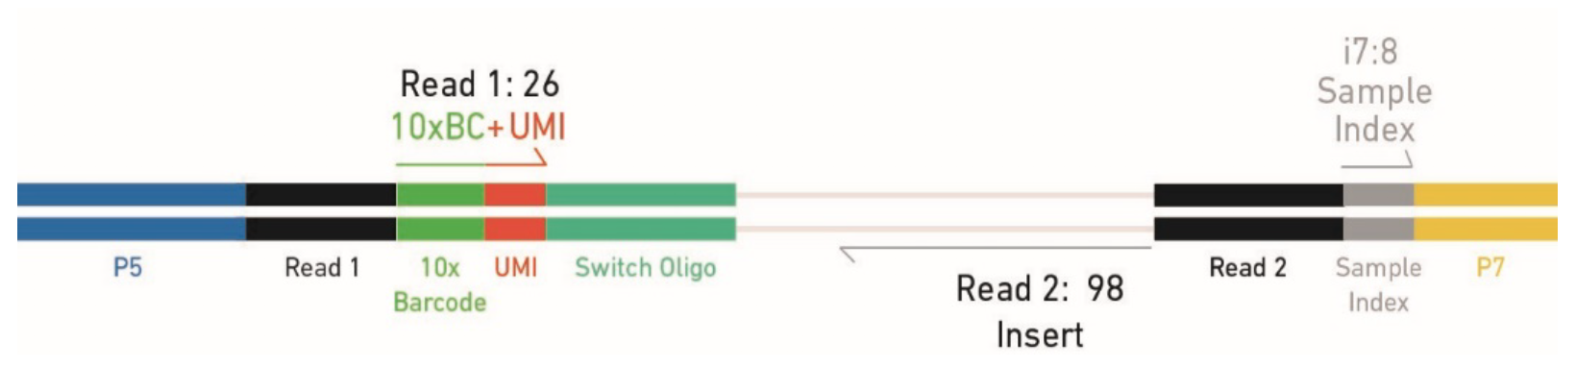
Raw sequencing files to count matrices
Step 1: BCL to FASTQ
Each fastq file generated by bcl2fastq contains different information:
I1.fastq contains sample index (for pooling together multiple samples)
R1.fastq contains cell barcode + UMI
R2.fatsq contains transcript information
R1.fastq
R2.fastq
I1.fastq

Slide 8
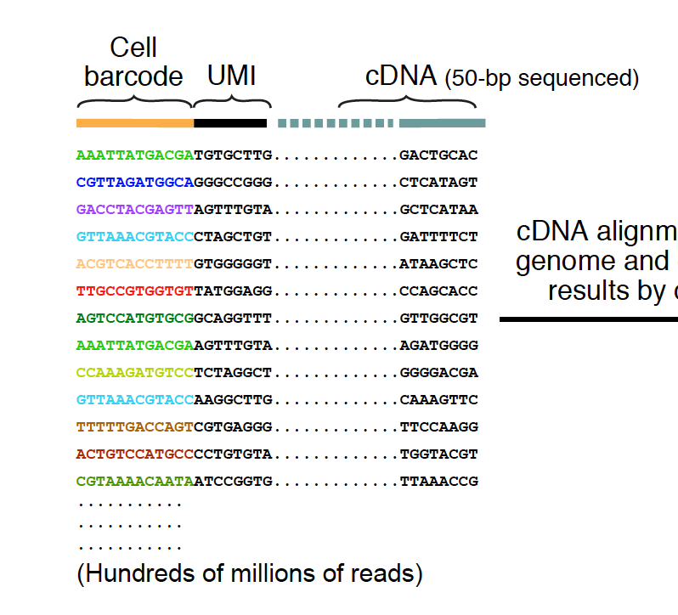
Raw sequencing files to count matrices
Step 1: BCL to FASTQ
An example of what the reads look like…
R1.fastq
R2.fastq

Slide 9
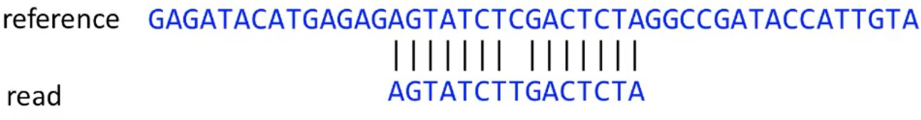
Raw sequencing files to count matrices
Step 2: Alignment to reference genome
The next step is to determine which gene each read originated from. In order to do this the read sequences are mapped to a precompiled genome reference.
Be mindful of reference versions and sources. Use the latest reference when possible.
Human reference, GRCh38 (GENCODE v32/Ensembl 98)
Mouse reference, mm10 (GENCODE vM23/Ensembl 98)

Slide 10
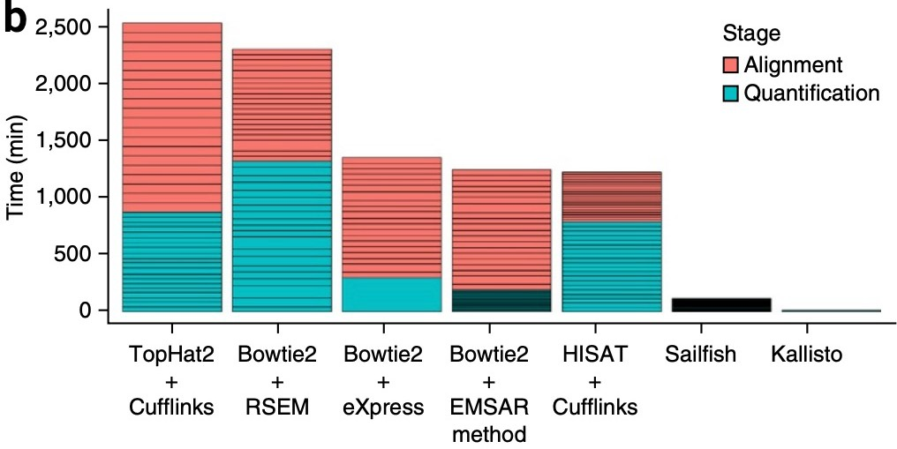
Raw sequencing files to count matrices
Step 2: Alignment to reference genome
The choice of aligner is often a personal preference and also dependent on the computational resources that are available to you.
https://hbctraining.github.io

Slide 11
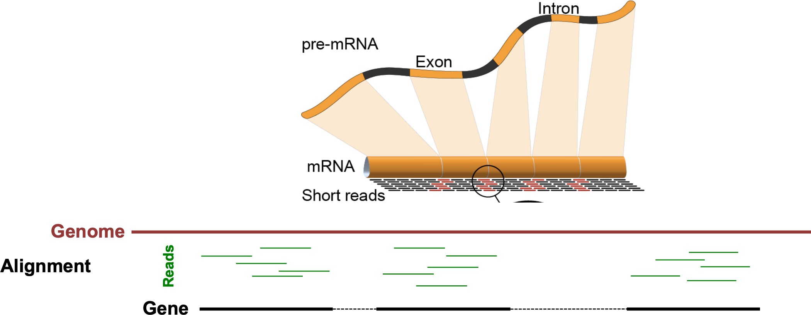
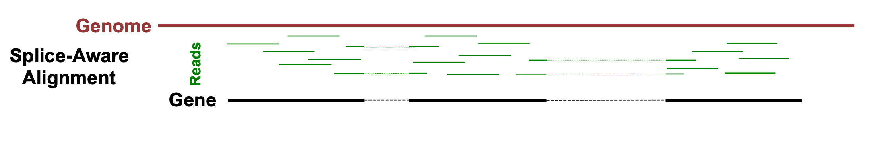
Raw sequencing files to count matrices
Step 2: Alignment to reference genome
10X Cellranger uses the STAR aligner.
Because of widespread splicing in animal genomes, read alignment against a genome should be done with a splice-aware aligner.
https://hbctraining.github.io

Slide 12
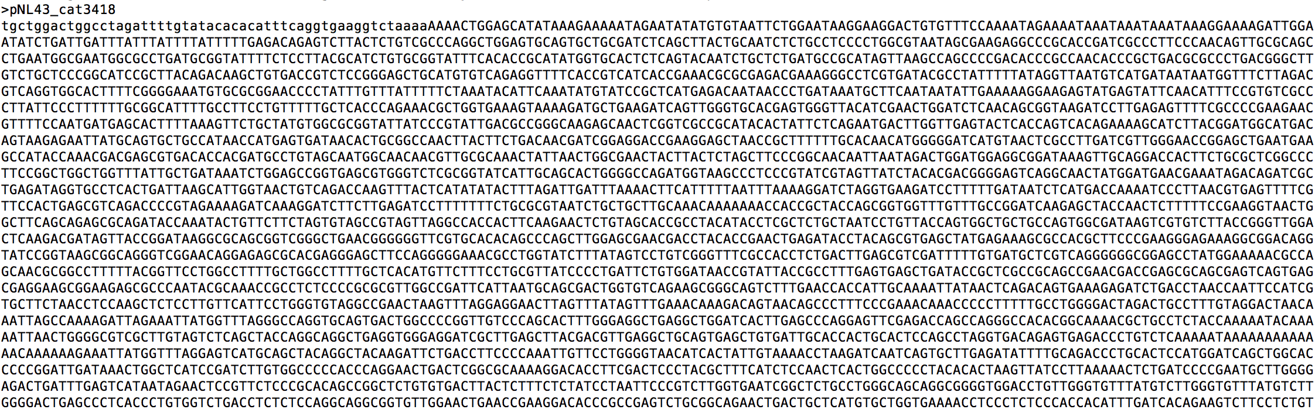
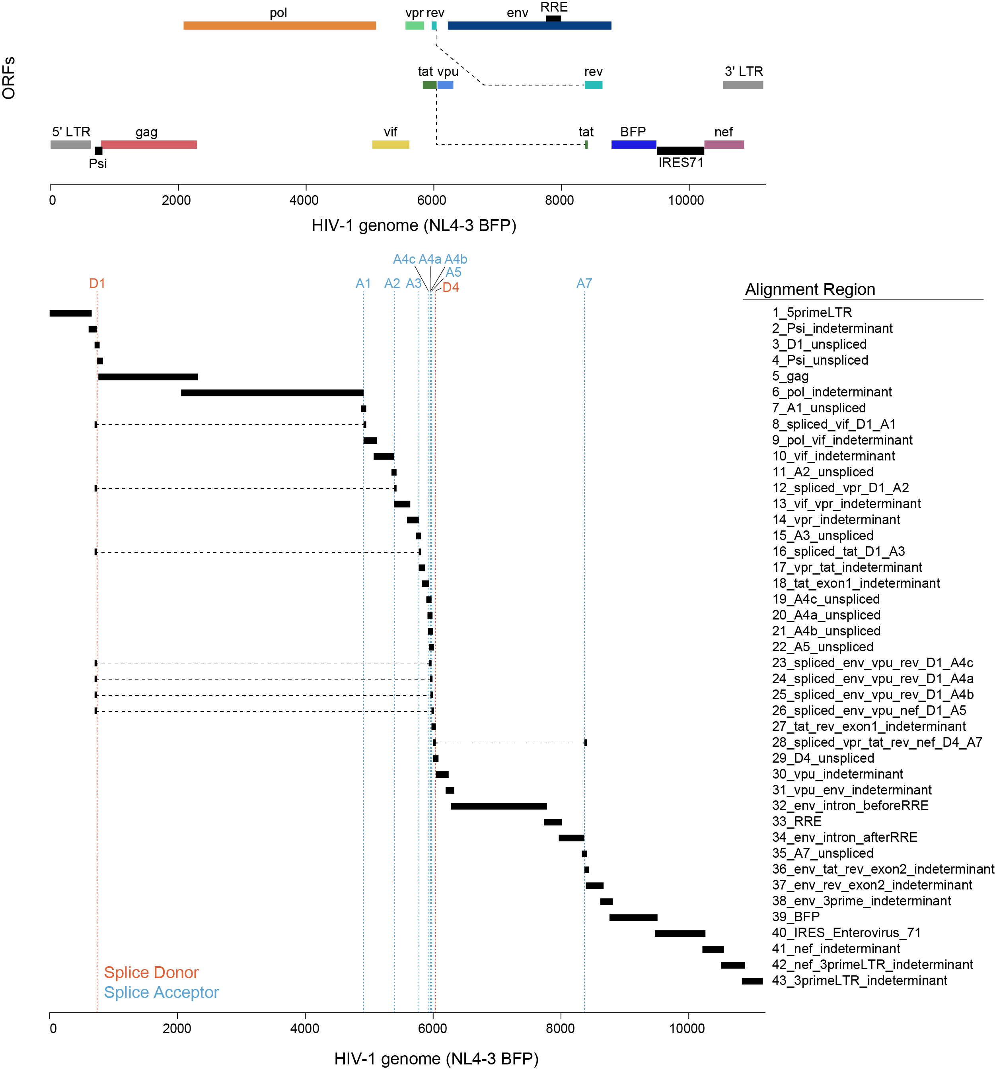
Raw sequencing files to count matrices
Step 2: Alignment to reference genome
Reference genomes can be customized to also detect “non-host” transcripts
Virus: poly-adenylated virus (e.g. HIV-1, Ebola, SARS-CoV2)
Artificial constructs: CAR, GFP, etc.
Simple approach: just adding the lentivirus as a single .fasta and full .gtf, gives binary + virus or - virus
Complex approach: annotating splice sites to understand HIV-1 life cycle

Slide 13
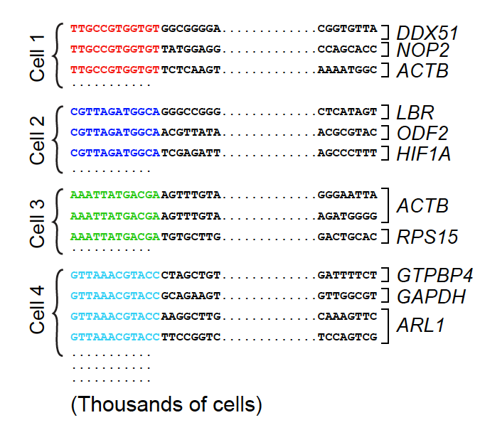
Raw sequencing files to count matrices
Step 3: Counting reads
Reads that have been confidently mapped to the transcriptome are then assigned to cells based on their barcode (cell barcode demultiplexing) and the the number of unique RNA molecules corresponding to each gene within each cell are counted (UMI deduplication).

Slide 14
Raw sequencing files to count matrices
Step 3: Counting reads
Reads that have been confidently mapped to the transcriptome are then assigned to cells based on their barcode (cell barcode demultiplexing) and the the number of unique RNA molecules corresponding to each gene within each cell are counted (UMI deduplication).
The result is the gene x cell matrix that is the starting point for downstream analysis.

Slide 15
Module 1 - pre-processing, quality control, normalization
1a. Going from raw sequencing files to gene count matrices.
1b. Working with count matrices:
Basics of bioinformatics tool-kits in omics research.
Quality control and normalization starting from gene count matrices.
Interacting with single-cell data in R: Seurat objects.

Slide 16
Basics of bioinformatics tool-kits in omics research.
Programming languages
R
python
package environments
Bioconductor
scverse

Slide 17
Basics of bioinformatics tool-kits in omics research.
Programming languages
R
python
package environments
Bioconductor
scverse
“Backbone” packages
Seurat / SingleCellExperiment
scanpy / anndata

Slide 18
Basics of bioinformatics tool-kits in omics research.
Programming languages
R
python
package environments
Bioconductor
scverse
“Backbone” packages
Seurat / SingleCellExperiment
scanpy / anndata
specialized packages
scRepertoire
scirpy

Slide 19
Determining cell type, state, and function
Quality control
Normalization
Feature selection
Dimensional reduction
Cell-cell distances
Unsupervised clustering
Kiselev C. at al. (2019) Nature Reviews Genetics. 20: 273-282.

Slide 20
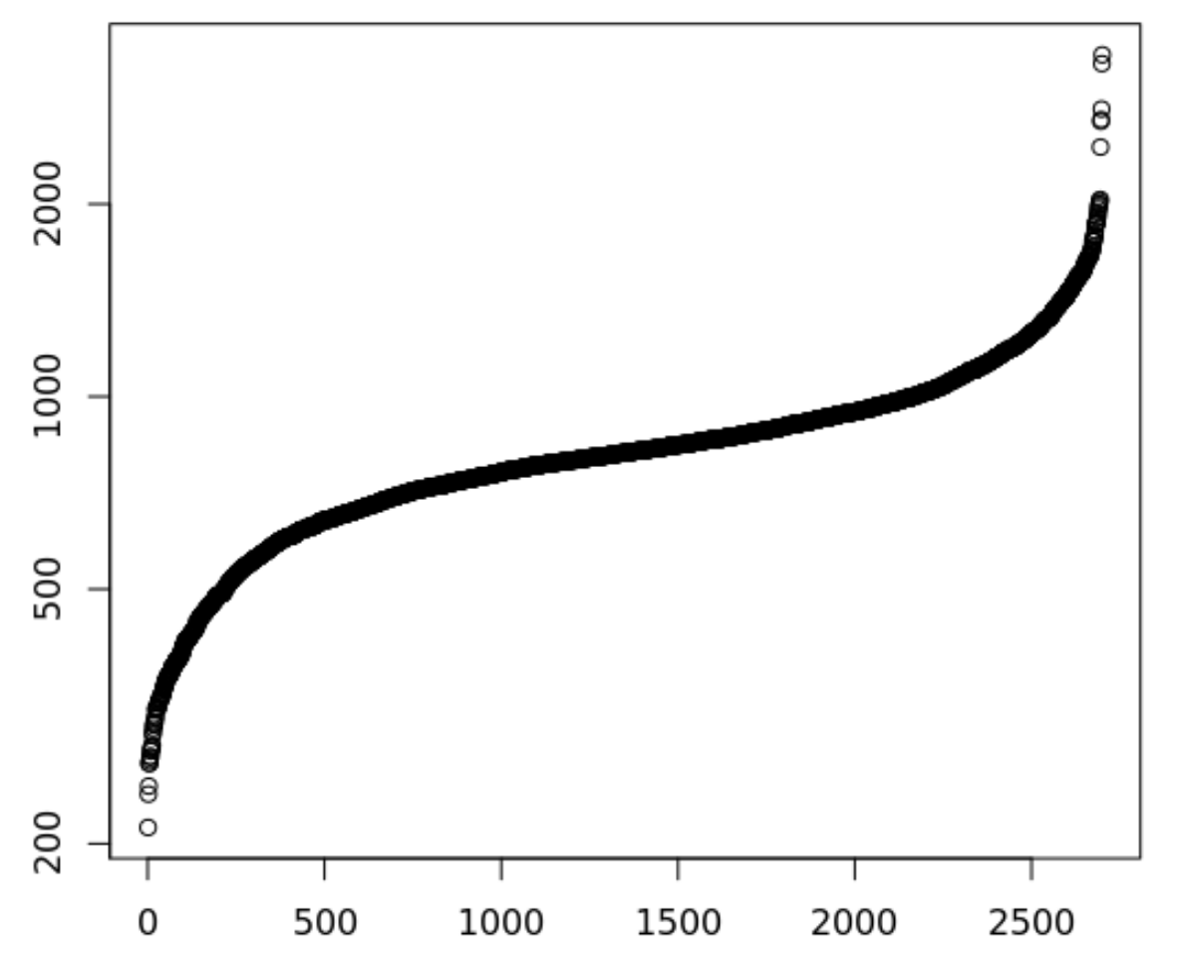
There are many quality control filters for genes and cells
Genes detected per cell (ordered)
Complexity =
Number of genes detected in a cell
Complexity
Complexity
Cell
Notes:
Filtering both ends. Lower: Failed libraries? Higher: Doublets?
Outlier cells are not just measured by complexity
•Percent Reads Mapping
•Percent Mitochondrial Reads
•Presence of marker genes
•Intergenic/ exonic rate
•5' or 3' bias
•other metadata …
•Useful Tools
Picard Tools and RNASeQC

Slide 21
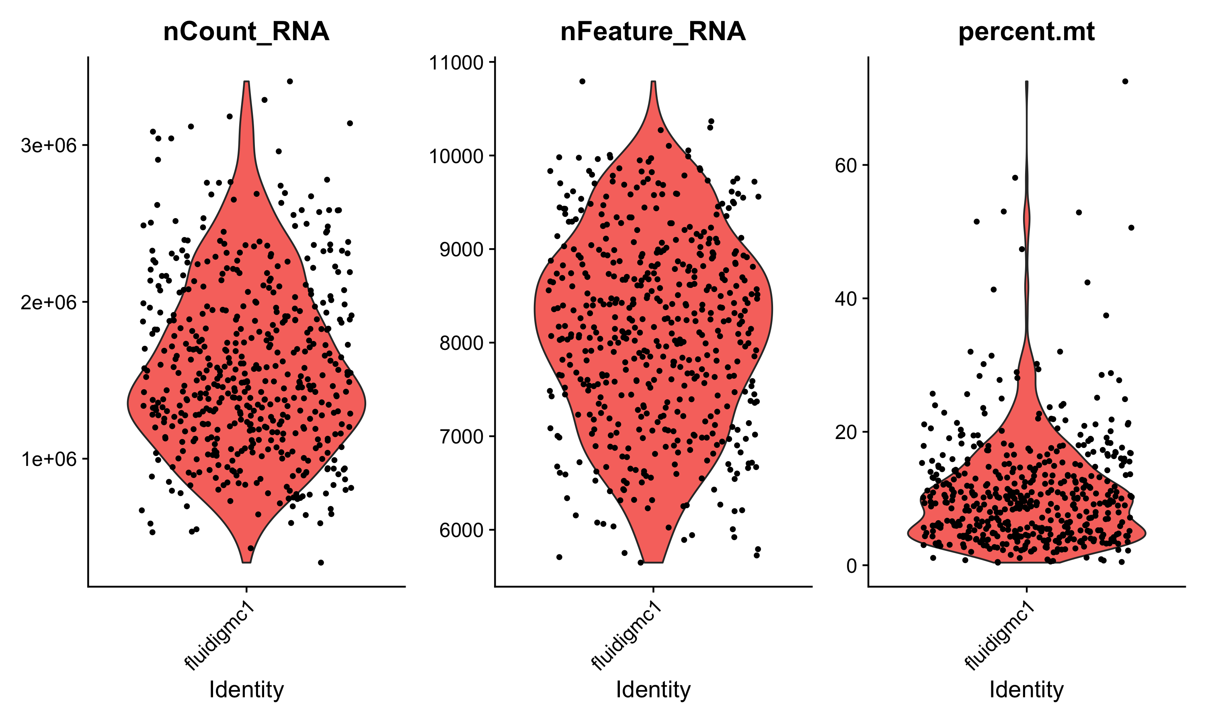
There are many quality control filters for genes and cells
We filter cells based on technical or biological parameters.
# reads or UMIs detected in a cell
# genes detected in a cell
% mito expression in a cell

Slide 22
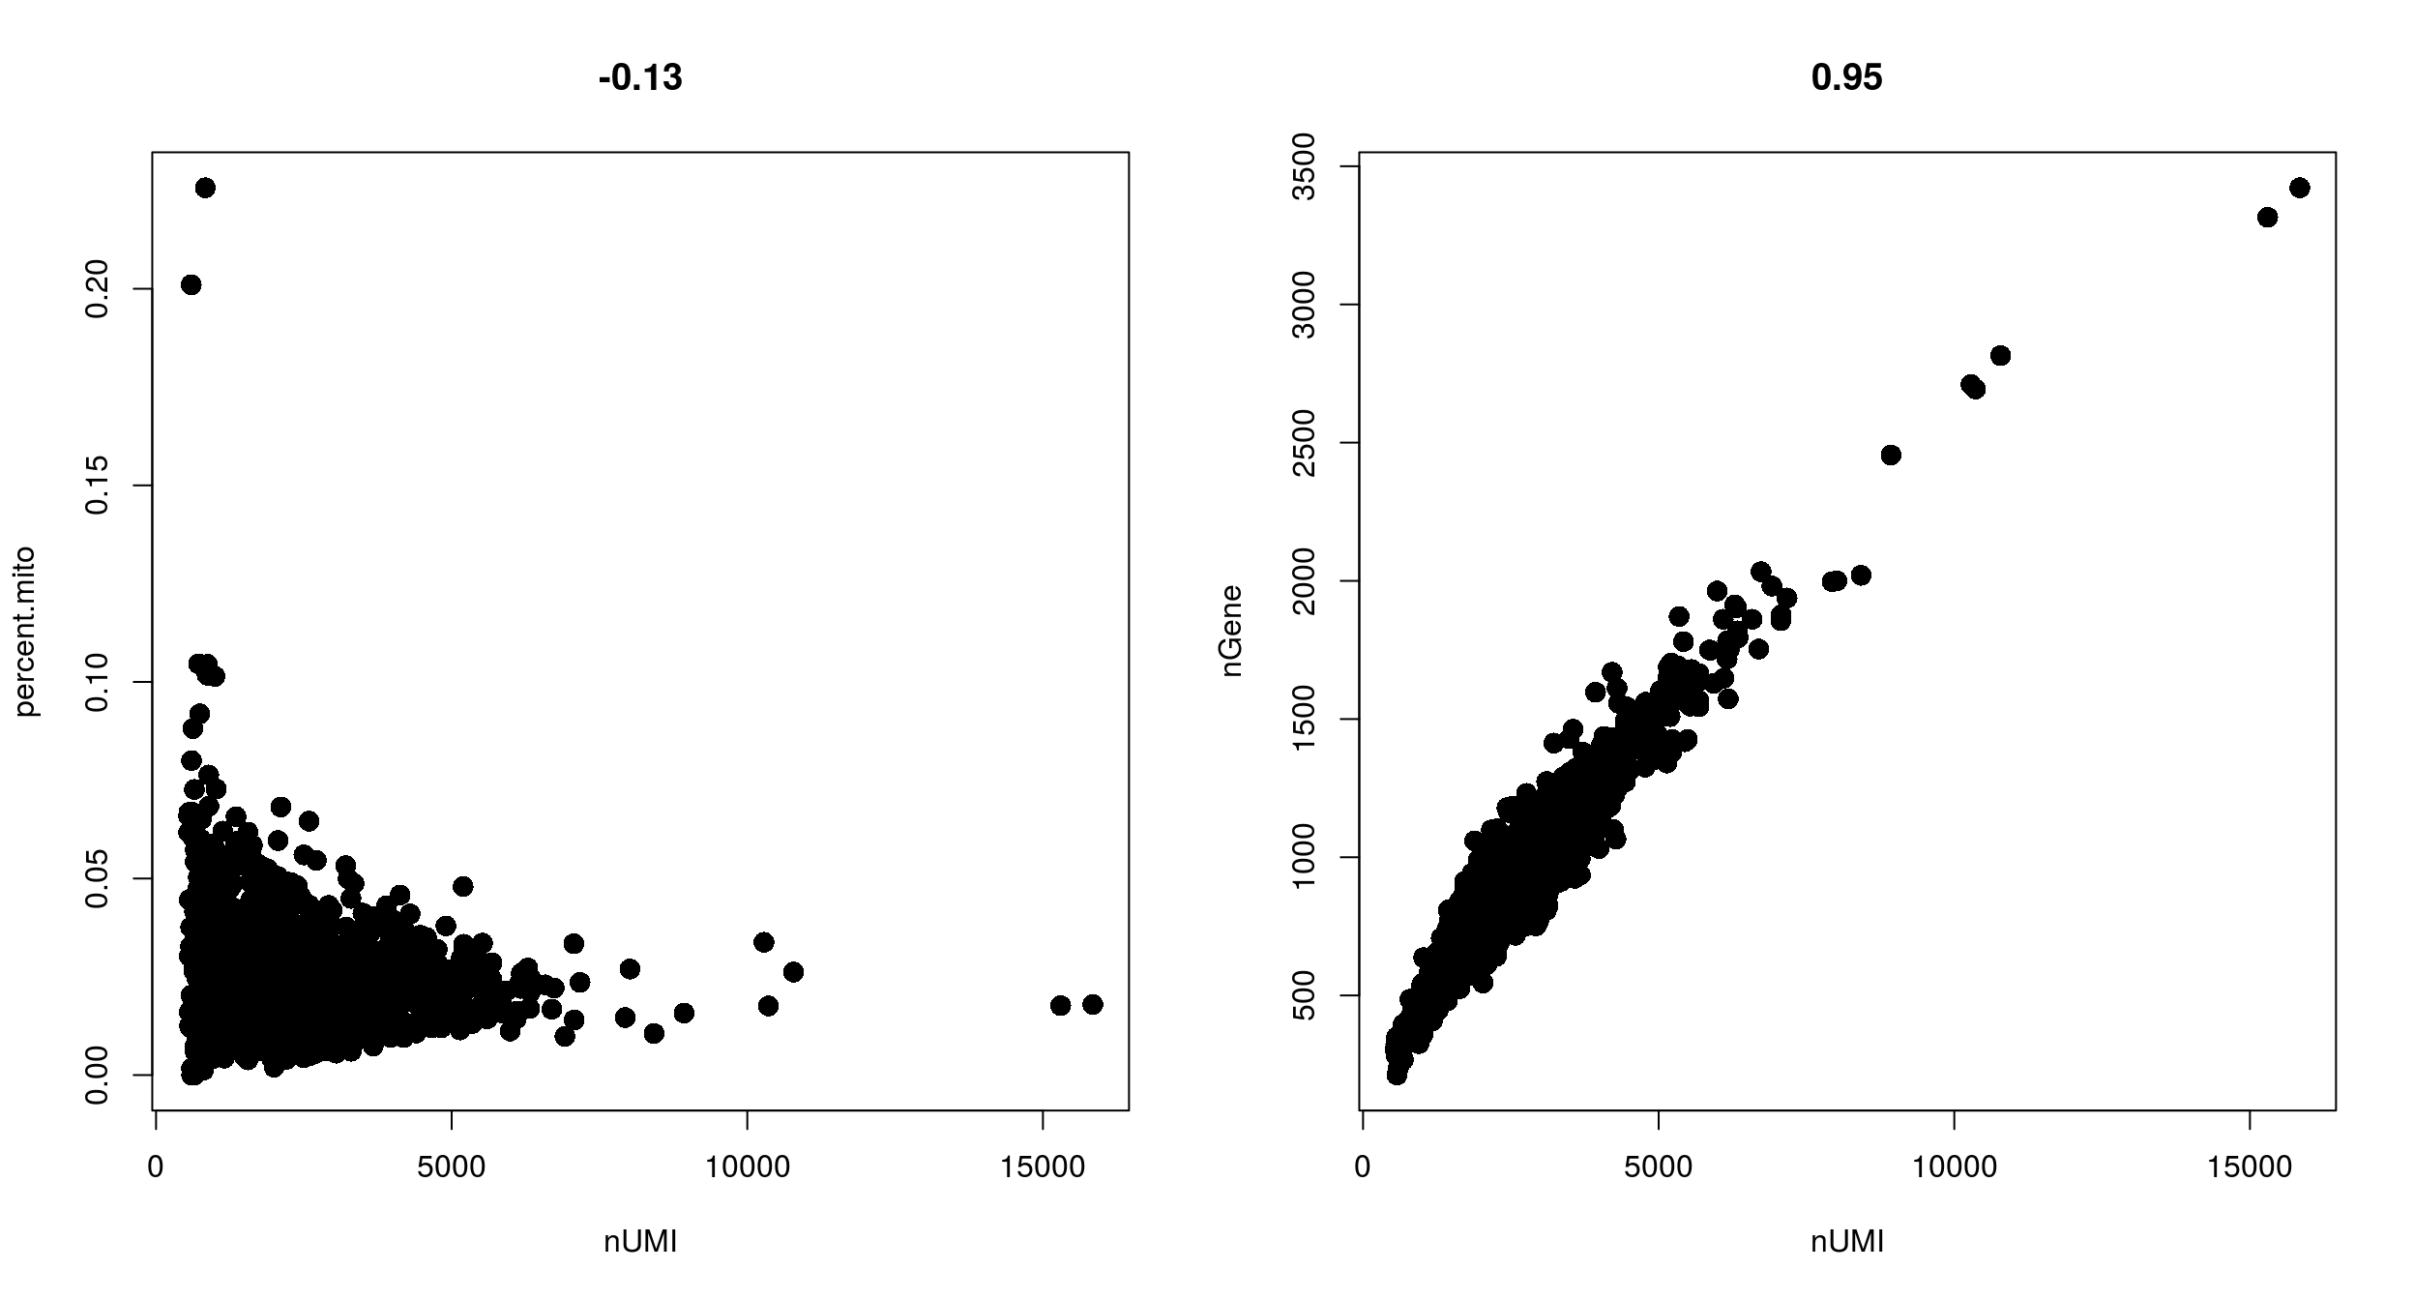
Filtering with combinations of quality control filters
Low nUMI and high % mitochondrial- Cells captured but lost a lot of the mRNA, and the mitochondrial genes were protected and retained
High nUMI & low nGene ratio – low quality library or capture rate
nGene
% mito
High nUMI & high nGene – doublets
nUMI
nUMI
Notes:
Cells got raptured and lost a lot of the mRNA, but the mitochondrial genes are protected (0.1, 10000)

Slide 23
Appropriate quality control filters vary with platform and
cell types
Different platforms set different expectations
e.g. Smart-Seq2 often yields more genes detected per cell than 10x Chromium.
Different cell types set different expectations
Immune cells normally have fewer genes detected per cell than non-immune cells
Malignant cells normally have more genes detected per cell than non-malignant cells
Notes:
Malignant cells are more transcriptional active

Slide 24
Detecting cell doublets with Scrublet
Scrublet (Single-Cell Remover of Doublets)
Wolock, Lopez, Klein. Cell Systems 8.4 (2019): 281-291.

Slide 25
Detecting cell doublets with Scrublet
Wolock, Lopez, Klein. Cell Systems 8.4 (2019): 281-291.

Slide 26
Detecting empty drops containing ambient RNA – manual
Look for transcripts expressed in unexpected cell types and remove those genes from all subsequent analysis
e.g. hemoglobin gene expressed in a T cell

Slide 27
Detecting empty drops containing ambient RNA – automatic
EmptyDrops (distinguish cells from empty droplets)
Cells ranked by total
unique molecular identifiers (UMI)
10000
1000
100
10
Cell encapsulated in droplet
Total UMI detected per cell
Mixture
Ambient RNA encapsulated in droplet
Lun, A.T.L. et al. Genome Biol (2019). 20, 63.

Slide 28
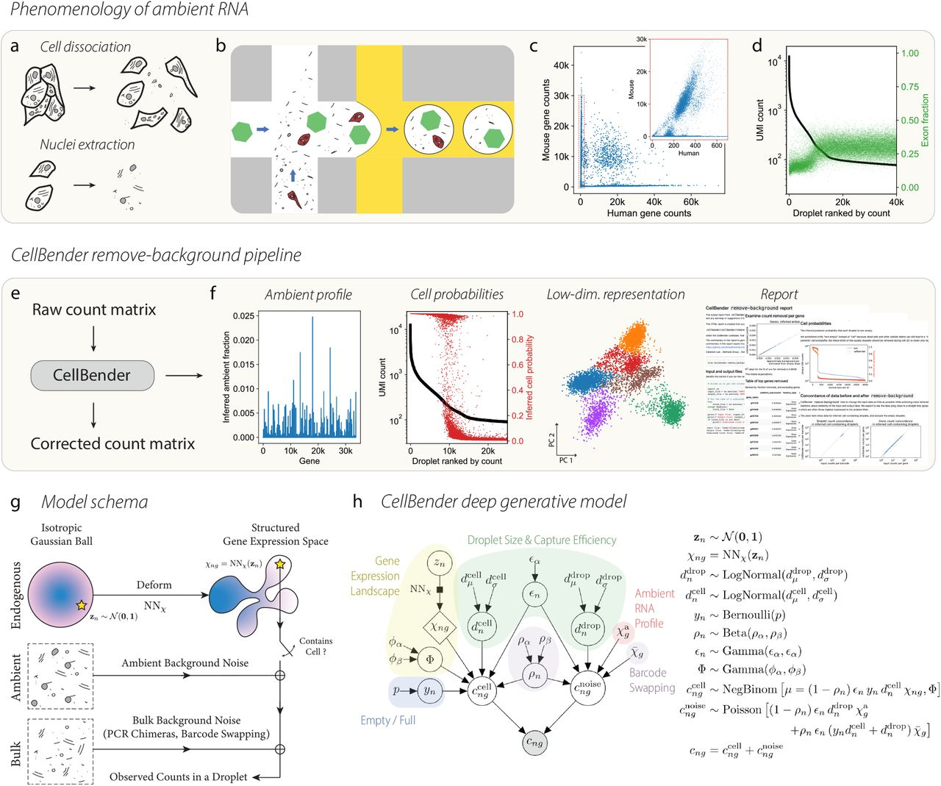
Further quality control to correct for ambient RNA
Cells ranked by total
unique molecular identifiers (UMI)
CellBender is a deep generative model of background-contaminated counts
correct ambient RNA and barcode swapping
detect empty droplets
10000
1000
100
10
Cell encapsulated in droplet
Total UMI in cell
Mixture
Ambient RNA encapsulated in droplet
Fleming S. J. et al. bioRxiv (2022).

Slide 29
Removing ambient RNA using CellBender in COVID-19 tissue
CellBender applied to COVID-19 lung tissue
CellBender qualitative observations
cell subsets become more distinct
cell type marker genes become more specific
can lower UMI and gene cutoffs, allowing for significantly more recovery of lymphocytes
Delorey T. et al. Nature (2021).
Notes:
SFTPA1 in AT2 cells

Slide 30
Quality control tips
We often revisit quality control decisions multiple times when analyzing data.
Start with permissive thresholds when filtering and investigate the effects of these thresholds before applying more stringent thresholds.
If the distributions of QC metrics differ between samples, thresholds should be determined separately for each sample to account for sample quality differences.
Visualize QC metrics per cell subset in order to flag technical biases.
Luecken M. D. et al. Molecular Systems Biology (2019) 15:e8746.

Slide 31
Determining cell type, state, and function
Quality control
Normalization
Feature selection
Dimensional reduction
Cell-cell distances
Unsupervised clustering
Kiselev C. at al. (2019) Nature Reviews Genetics. 20: 273-282.

Slide 32
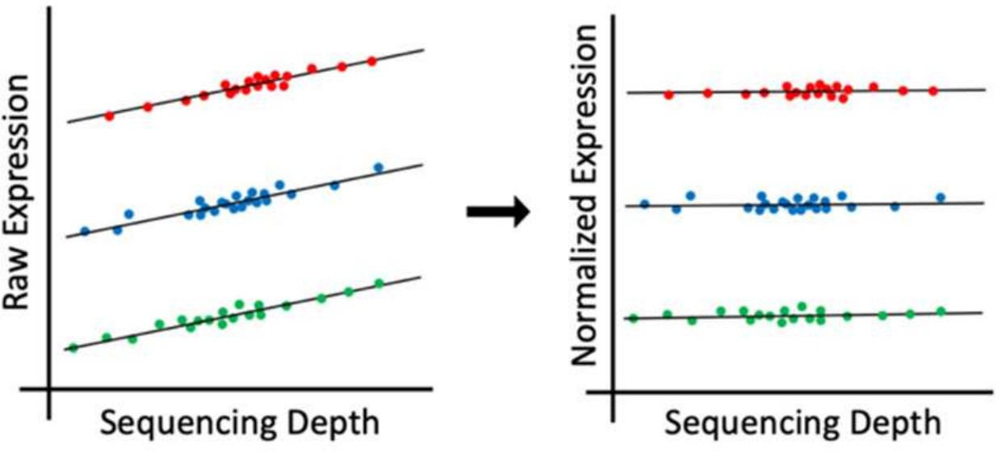
Single-cell RNA-Seq analysis: normalization
Why normalize gene expression within a cell?
Cells are sequenced to different depths (total number of molecules sequenced).
There are typically extreme values in distribution of gene expression
cell type 1
cell type 2
cell type 3
Differences in sequencing depth can lead to false differences in gene expression.

Slide 33
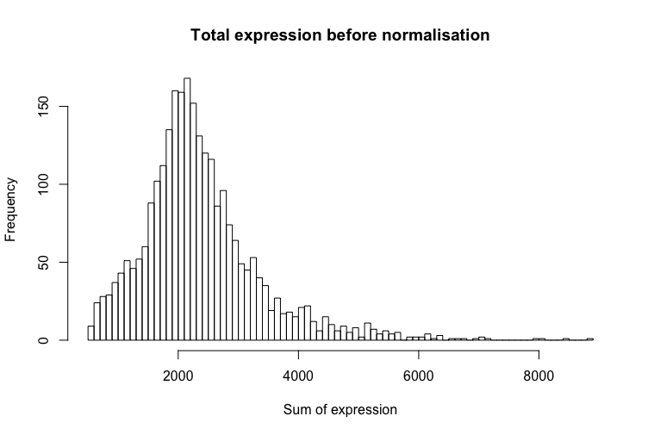
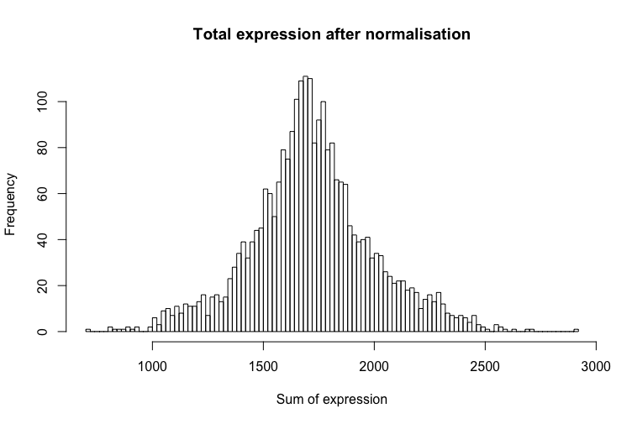
Single-cell RNA-Seq analysis: normalization
The goal of normalization is for differences in normalized read counts to represent differences in true expression.
Common normalization approach
Gene expression measurements for each cell are normalized by the total gene expression.
Gene expression values are next scaled to sum to 10,000 and then log(1+x)-transformed.
hbctraining.github.io/main
Notes:
Next we carry our normalization within each single cell. The total gene expression within a cell is the sum of the expression levels of all genes in the cell, and due to technical reasons, the total gene expression across individual cells often varies a lot. This is a confounding factor in analysis.

Slide 34
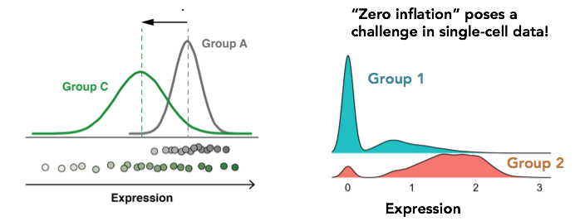
Is standard normalization appropriate?
Reassessing the idea that droplet scRNA-Seq is zero-inflated.
“Droplet scRNA-seq is not zero-inflated.” Svensson, Nature Biotechnology (2020)
”Feature selection and dimension reduction for single-cell RNA-Seq based on a multinomial model.” Townes et al. Genome Biology (2019)
“Normalization and variance stabilization of single-cell RNA-seq data using regularized negative binomial regression.” Hafemeister et al. Genome Biology (2019) - sctransform
Single
cell
Bulk

Slide 35
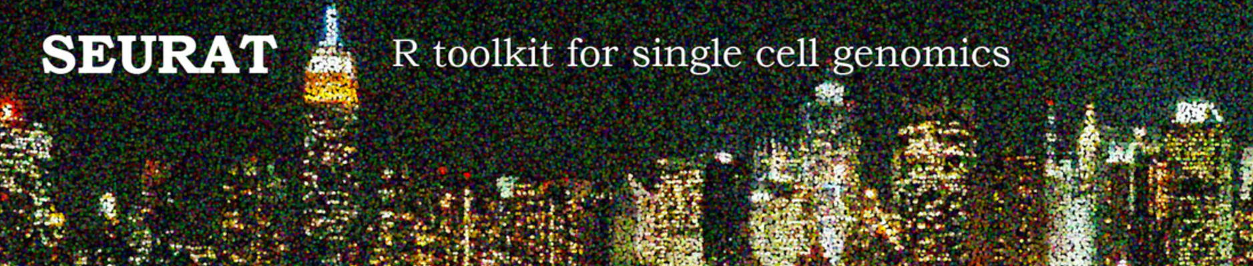
Interacting with Seurat objects
Seurat object is used for to store 10x data and perform analysis
Count matrices for different assays are stored (gene expression, protein expression, chromatin accessibility, etc…)
Counts are stored as: counts (raw), data (normalized), scaled data (centered and scaled) in sparse matrices when possible
Metadata describes individual cells and genes
Functions for analysis (quality control, normalization, feature selection, dimensional reduction, cell-cell distances, unsupervised clustering)
https://github.com/satijalab/seurat/wiki
https://satijalab.org/seurat/essential_commands.html

Slide 36
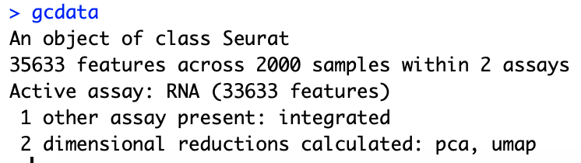
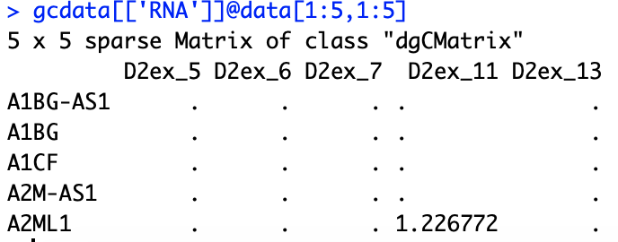
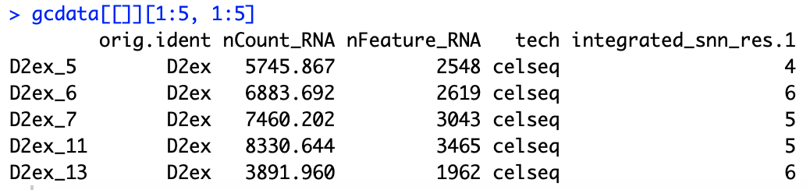
Interacting with Seurat objects
Seurat object
Accessing count slot from RNA assay
Accessing cell metadata
Running analysis function

Slide 37
Loading data into a Seurat object
gcdata <- CreateSeuratObject(counts = celseq.data)
counts matrix

Slide 38
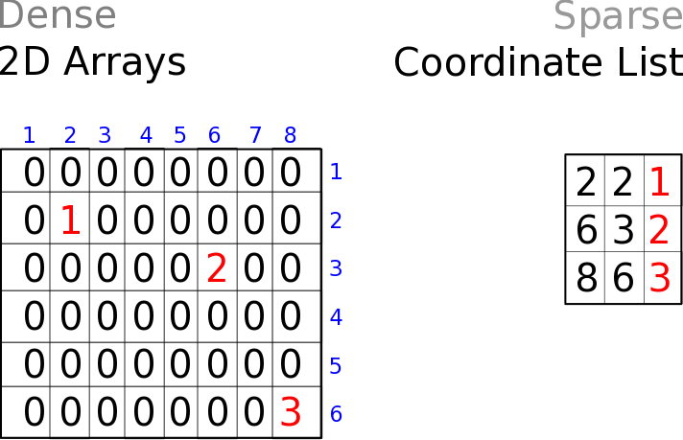
Storing counts data in dense vs sparse format
cells
genes
Dense matrices
Sparse matrices

Slide 39
Suggested reading
Reviews:
Luecken M. D. et al. Molecular Systems Biology (2019) 15:e8746.
Kiselev C. et al. (2019) Nature Reviews Genetics. 20: 273-282.
Tutorials:
https://satijalab.org/seurat/articles/pbmc3k_tutorial
https://scanpy.readthedocs.io/en/stable/tutorials/basics/clustering.html
Software:
Single-cell analysis in R:
Seurat: https://satijalab.org/seurat/
Single-cell analysis in python:
Scverse: https://scverse.org/
scanpy: https://scanpy.readthedocs.io/en/stable/

